Slide 1
Imbalanced Data in Machine Learning
By Owais Ahmed Khan

Slide 2
Imbalanced Dataset
An Imbalanced Dataset is a dataset where one or more labels make up the majority of the dataset, leaving far fewer examples of other labels.
In many scenarios, getting more data for the minority class may be impractical or hard to acquire because the data is inherently imbalanced.
E.g. Fraud detection and detection of rare diseases.

Slide 3
Why it causes problems?
The model cannot learn to predict the minority class well because of class imbalance.
A Model can only learn a simple heuristic (e.g. always predict the dominant class) and gets stuck in a suboptimal solution.
An accuracy of over 90% can be misleading because the model may not have predictive power on the rare class.
Often minority class is more important than the majority class. A wrong prediction about a minority class is more costly than an incorrect prediction about the majority class.
E.g. Missing a fraudulent transaction is 100x more costly than misclassifying a legitimate example as fraud.

Slide 4
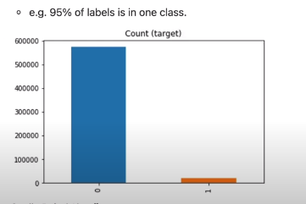

Slide 5
How to deal with imbalance dataset
Data-level Resampling
Model-level
Metric-level

Slide 6
Resampling
Change the distribution of the training data to reduce the level of class imbalance.
Over-sampling (Upsampling):
Randomly make copies of the minority class until a ratio is reached.

Slide 7
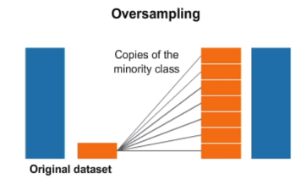

Slide 8

SMOTE(synthetic minority oversampling technique)
It creates synthetic examples of the rare class by combining original examples. It does this using a nearest neighbors approach.

Slide 9
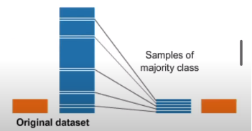

Random Under-sampling
Removes examples from the majority class.

Slide 10
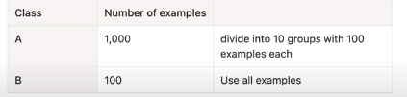
Ensemble method
Use all samples of the minority class and a subset of the majority class to train multiple models and then ensemble those models.

Slide 11
